Slide 1
Distributed Streaming Processing
Ardeshir Soltani Nejad
Lyubomira Gerova
Yordan Grigorov
DBPRO WS19/20, TU Berlin

Slide 2

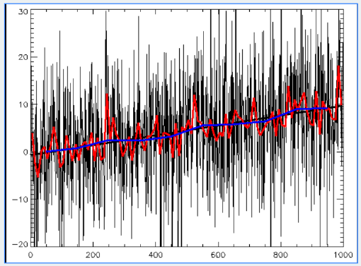
Introduction
Data series with flink
Experiment with filters
Stream processing platform
Today focus on:
Audio signals
LPC + Durbin
Notes:
Our project topic is processing data series with Flink and experimenting with filters. Data series is basically data, where each data point has a specific timestamp attached to it. Some examples are: Stock market values, annual measurements of, say, temperature, and sound waves. Flink, as you all probably know, is a platform for stream processing, well suited for this kind of input.
The data WE want to process is audio. Our goal is to implement the Linear predictive coding method(LPC) in Apache Flink
So today our focus will be firmly set on Audio and the actual LPC method

Slide 3
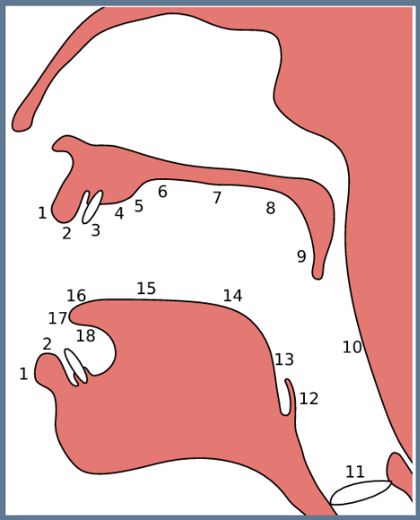
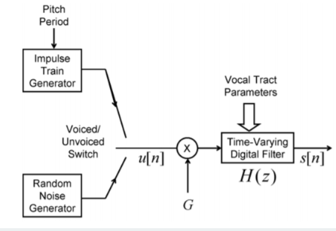
Human Speech
(11) Glottis: where voice is generated.
(the rest): where sound is manipulated
Voiced/Unvoiced sounds depending on glottis.
Notes:
Before we dive into the algorithm itself, we need to understand the nature of our input. In the middle you can see a picture of the human vocal tract.I want you to focus on the bottom of the picture, labeled with number 11 is the glottis, the voice box. This organ vibrates and produces waves when we speak. You can feel the vibration if you touch it while speaking.
But that is not all there is to it. The rest of the mouth acts like a filter to your voice, enabling you to produce and differentiate between sounds like a and o.
There is a subset of sounds in which your voice box does not vibrate. For example /f/. The sound you just heard is produced by the turbulence between my lip and my teeth. It is unvoiced.
On the left side you can see a model describing human speech in a more mathematical way. The box that says "Impulse train generator" represents the vibrations coming from your voice box when activated. Below is the "random noise generator". This is the turbulence coming from your lungs when the voice box is off. The "time-varying filter" represents the way your mouth further develops the sound.

Slide 4

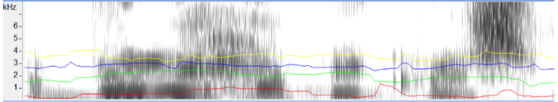
Notes:
Let’s have a look at formants

Slide 5
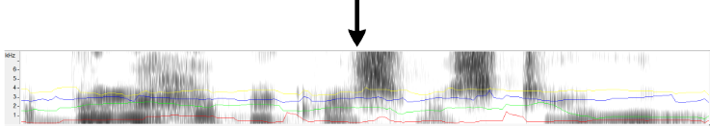
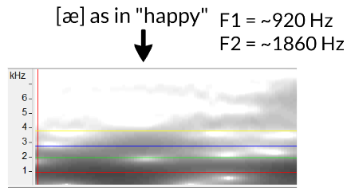
"A very happy Christmas to you all"
Changes in sounds are infrequent:
->Take advantage with LPC
Estimate the formants
Remove their effect
Estimating intensity and frequency of remaining buzz
Notes:
This is called a spectrogram. It is very powerful when describing human speech. On the spectrogram are plotted the first, second, third and fourth formants. If we zoom in on the part where she says "happy", we read the values 920 and 1860Hz for the first and second formant. These values correspond to the first vowel in happy.
As you can see, the way the sound changes when we speak can be easily foreseen. It is not just random noise. To analyse it, we can use the LPC method. In short, LPC estimates the formants. Removes their effect from the speech signal. FInally, it estimates the intensity and frequency of the remaining buzz

Slide 6
Human Speech
(11) Glottis: where voice is generated.
(the rest): where sound is manipulated
Voiced/Unvoiced sounds depending on glottis.
Notes:
by doing this, we have separated the impulse generator from the filter that we can see in the picture. If we want to reproduce the sound, we just have to run our source (voice buzz) through the filter (formants).

Slide 7
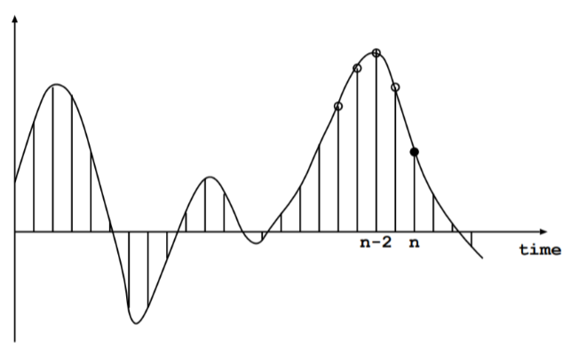
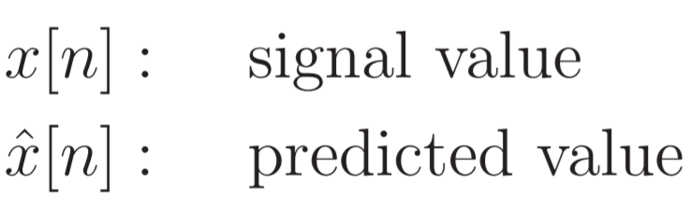
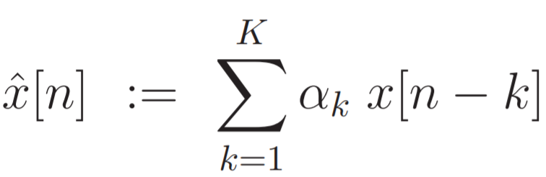
LPC - Linear Predictive Coding
(1)
n - point in time
K - number of previous samples
α - predictor coefficients
Notes:
LPC - Linear Predictive Coding, is the most widely used method for speech processing and provides highly accurate estimates of speech parameters. You can see on the left how we have signal values in different points in time - n the current one, n-1 previous one and so on.
The basic idea of Linear Prediction is that current speech sample x[n] can be closely approximated as a linear combination of K number of past samples (equation 1). This number K can be chosen freely, for example we take the past 10 samples.

Slide 8
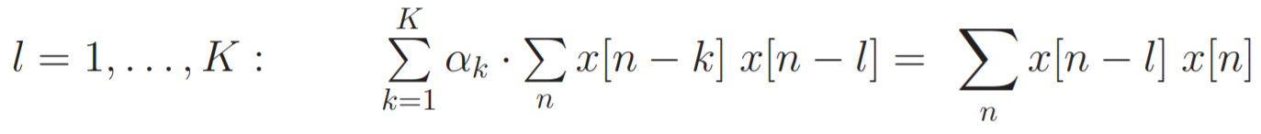
Linear Predictive Coding
Goal:
Find the predictor coefficients α(k), k = 1, ..., K by minimizing mean-squared error E
(1)
(2)
How do we find α(k)? - Autocorrelation method
Notes:
Now the goal is to find the predictor coefficients - the alphas.
They are determined by minimizing the sum of squared differences (in other words errors) between the actual speech samples and the linearly predicted ones. Here this is skipped for simplicity purposes. But as a result of it, we get the following equation 2. Now, how do we find the alphas? This can be done in several ways, but we decided to use the Autocorrelation method.

Slide 9
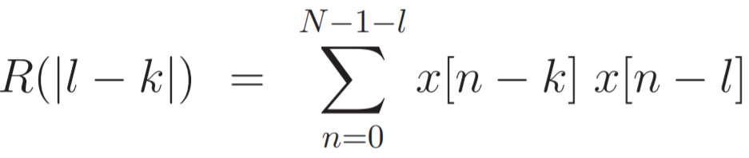
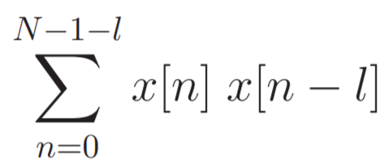
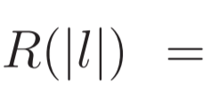
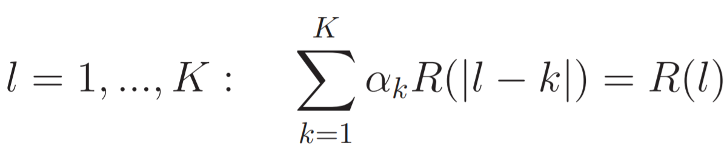
Autocorrelation function
;
(2)
(3)
Notes:
The autocorrelation method uses the autocorrelation function R. That’s where its name comes from. We can see 2 formulas for the autocorrelation function at the top row. I will not go into details about this function, because Yordan will show you some examples of autocorrelation in a minute, so don’t worry if you don’t understand it completely. The idea is that a similar pattern is found in this function and our equation 2 from the previous slide (the green and the orange one). So, now we just replace the highlighted parts with their corresponding R formula, resulting in equation 3.

Slide 10
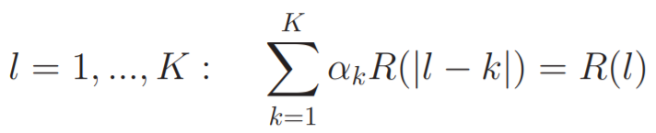
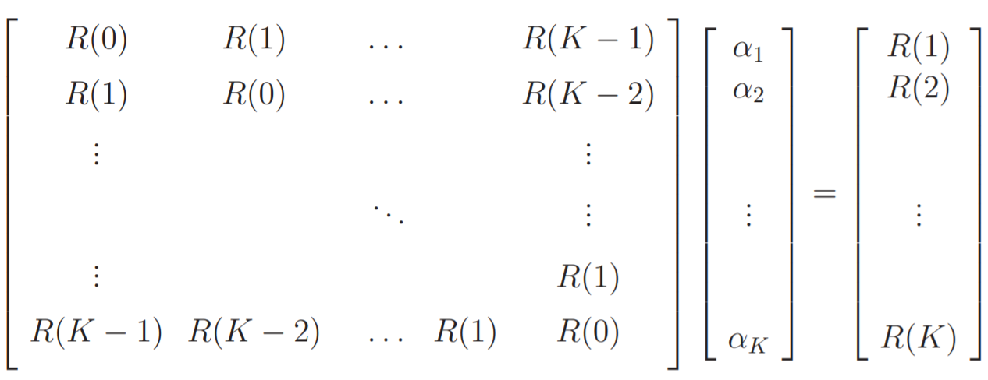
Levinson-Durbin Algorithm
(3)
In matrix form: Rα=r
R is a symmetric Toeplitz matrix
Notes:
Equation 3 from the previous slide can be expressed in a matrix form with capital R being a symmetric Toeplitz matrix.
There exist more efficient algorithms to solve alpha than simple matrix inversion. Levinson-Durbin algorithm takes advantage of the fact that R is a Toeplitz matrix and hence it doesn’t need to calculate every single value, but only the values on and above the diagonal. Using recursion, the vector consisting of alphas is easily calculated, which is exactly what our goal was.

Slide 11
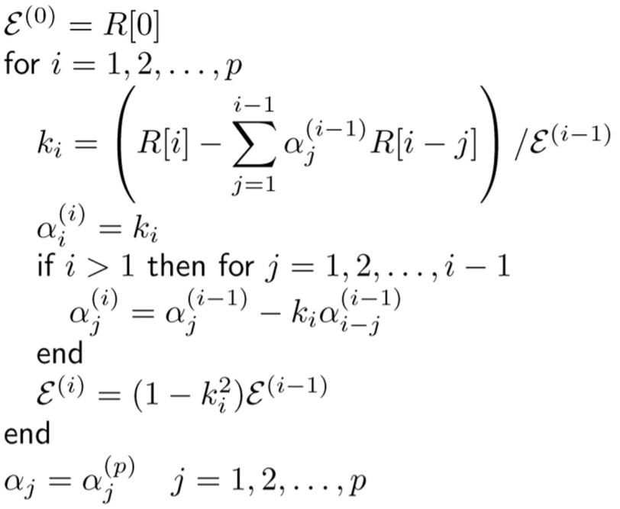
Levinson-Durbin Algorithm - Pseudo code
p - number of previous samples
E - error k(i) - intermediate coefficients α(p) - predictor coefficients
Notes:
This is a pseudo code for the Levinson-Durbin Algorithm. The key places are highlighted in red. That’s where our alphas are computed. I know this might seem overwhelming at first, but it’s actually pretty simple to calculate, since we already have all what we need - the exact formula for autocorrelation, and the formula for computing the errors.

Slide 12
Summary of LPC
1. Use p order linear predictor to predict signal value x[n] from p previous samples
2. Minimize mean-squared error E
3. Find the optimum predictor coefficients {α(k)} with the Autocorrelation method
4. Resulting Toeplitz matrix from the autocorrelation can be solved with the Levinson-Durbin Algorithm
5. The result of the algorithm consists of the {α(k)} coefficients and the errors
Notes:
Let’s summarized what I said with simpler words.

Slide 13
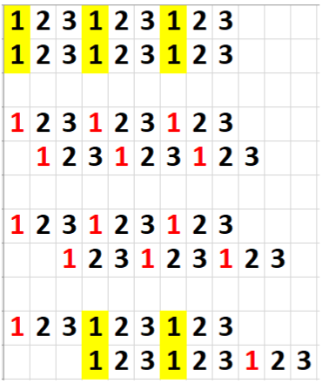
AUTOCORRELATION
Correlation of a signal with a delayed copy of itself
Mathematical tool for finding repeating patterns
Notes:
In autocorrelation, we receive a signal, for example 1,2,3,1,2,3 and so on. Naturally, the signal correlates with itself.
But if you push the "copy" of the signal one step further, the correlation is broken. If you do this often enough, you might end up in a situation where both signals line up again. That would never happen, if the signal was not repeating itself in the first place.

Slide 14
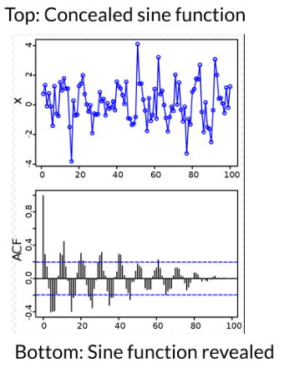
Sine function + 100 random points
Autocorrelation reveals the pattern
Notes:
A good example of a repeating signal is the sine function. On the top right corner you can see the sine function, but that's not easily recognizable because we've added noise -> random data points that are irrelevant to the sine function. Nevertheless, running autocorrelation on that reveals a clear sine pattern.

Slide 15
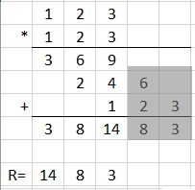
Notes:
That is all well and good, but let's see how to actually compute that. We have a very simple signal - just 1,2,3
First, we multiply the whole signal with the rightmost number (in this case - three). Then we skip one cell and multiply the whole signal with the second two last number (2). And so on. As you can see, we get a symmetrical pattern. From now on, I will skip the gray part, because we don't need to compute that. We can stop right after our biggest number (in this case 14). Usually, we reverse the answer, so the asnwer is: 14, 8 and 3. Let's try the same thing with a bigger signal

Slide 16
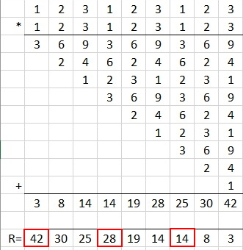
Notes:
This time, our signal contains a pattern. An interesting thing to note is that this is reflected in the answer. Usually, the numbers in our final vector would go down in value for every iteration where the signal and its copy do not line-up, however every 3 steps, those numbers refuse to go down, which is an interesting property of autocorrelation.
I have shown you how to find the autocorrelation for maximum lag. If we only want to compute the vector for one unit of lag, we would trim the result to the first two numbers: 42 and 30.For 2 units of lag that would be the first 3 elements and so on.

Slide 17

What is Octave?
Octave is a high-level interpreted language
Built with the intentions for numerical computations
Has capabilities for data visualization
Primarily used as a prototyping tool to find solutions before implementing them into another programming language.

Slide 18
Why Octave?
Octave makes it incredibly fast to implement idea’s from
many fields of math and data analysis.
Octave is free compared to it’s most popular opposition MatLab.
Ability to plot graphs on your data straight out of the box.
Supports data types like Vectors and Matrices
Supports built-in functions to read signals as input

Slide 19
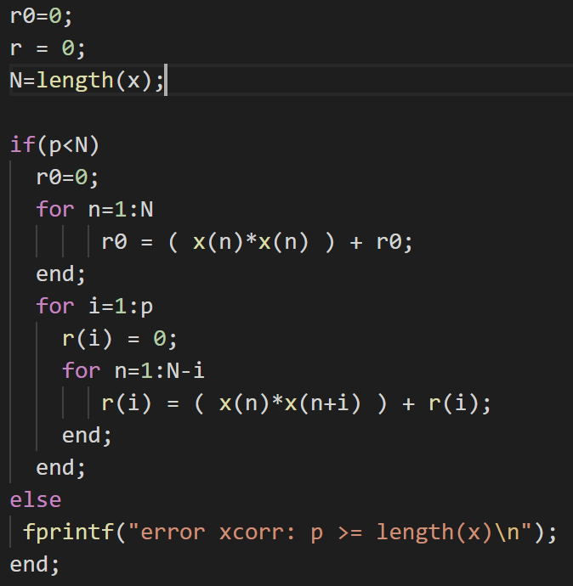

Examples

Slide 20
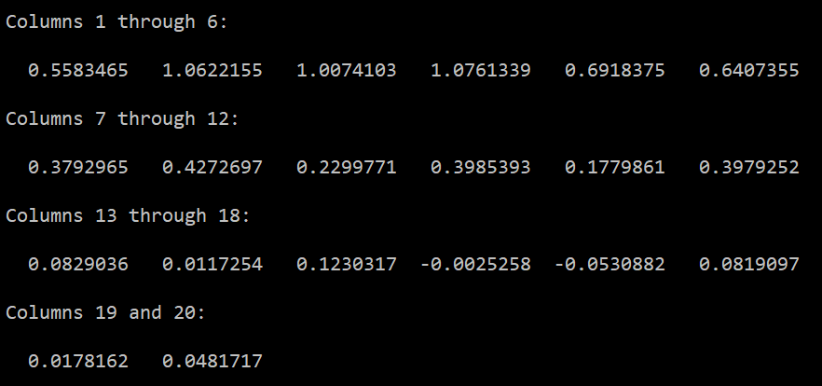
Result: 20 LPC Coefficients

Slide 21
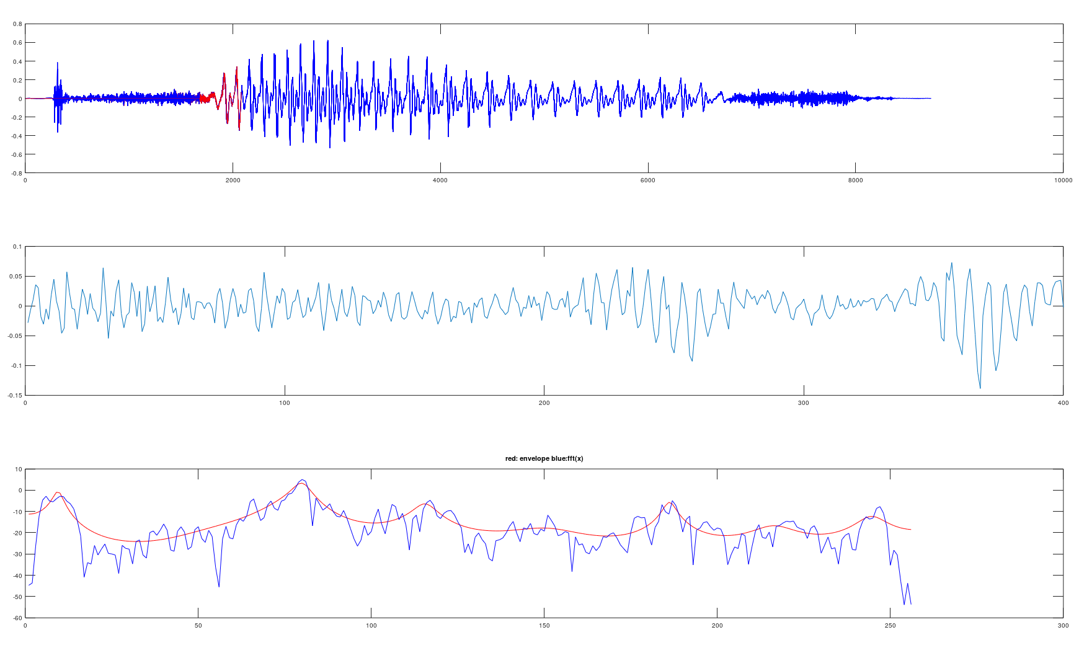
Visualization

Slide 22
TO DO
Implementing LPC Analysis in Apache Flink using:
Concept of Windowing
Concept of Real Time Stream Processing

Slide 23
Sources
Ece.ucsb.edu. (2019). [online] Available at: https://www.ece.ucsb.edu/Faculty/Rabiner/ece259/digital%20speech%20processing%20course/lectures_new/Lecture%2013_winter_2012.pdf [Accessed 7 Dec. 2019].
Www-i6.informatik.rwth-aachen.de. (2019). [online] Available at: https://www-i6.informatik.rwth-aachen.de/web/Teaching/Lectures/WS06_07/Signal/skript.pdf [Accessed 7 Dec. 2019].
https://www.gnu.org/software/octave/about.html

Slide 24
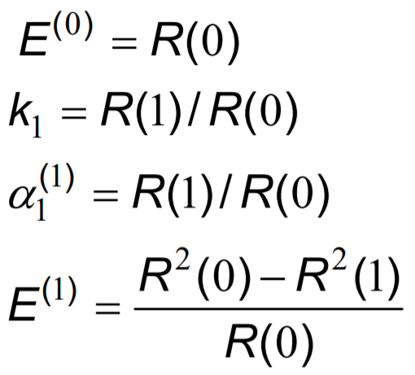
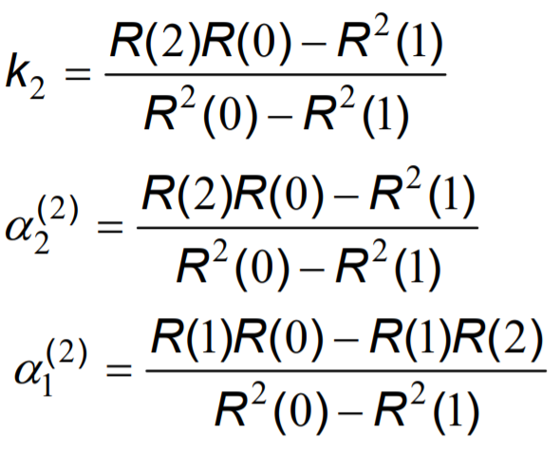
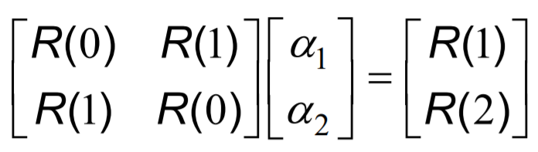
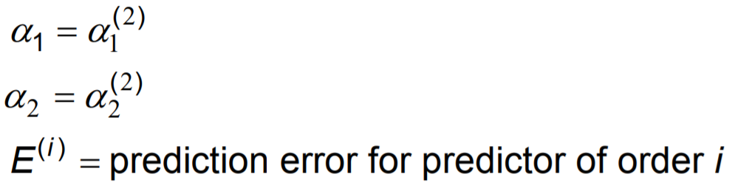
Levinson-Durbin Algorithm - example
Given p = 2:
with solution:

Slide 25
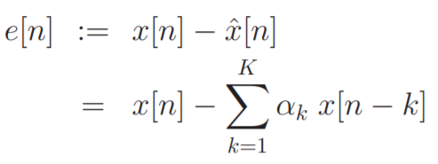
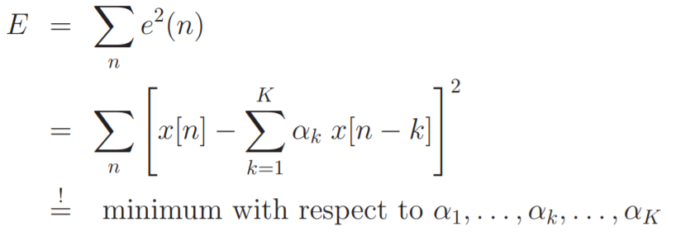
LPC - Error
Prediction error for each point n in time:
Squared error criterion E:

Slide 26
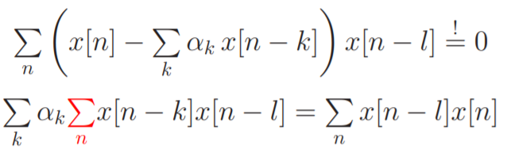
LPC - Error
Taking the derivative ∂/∂αl for l = 1, . . ., K results in:
(2)

Slide 27
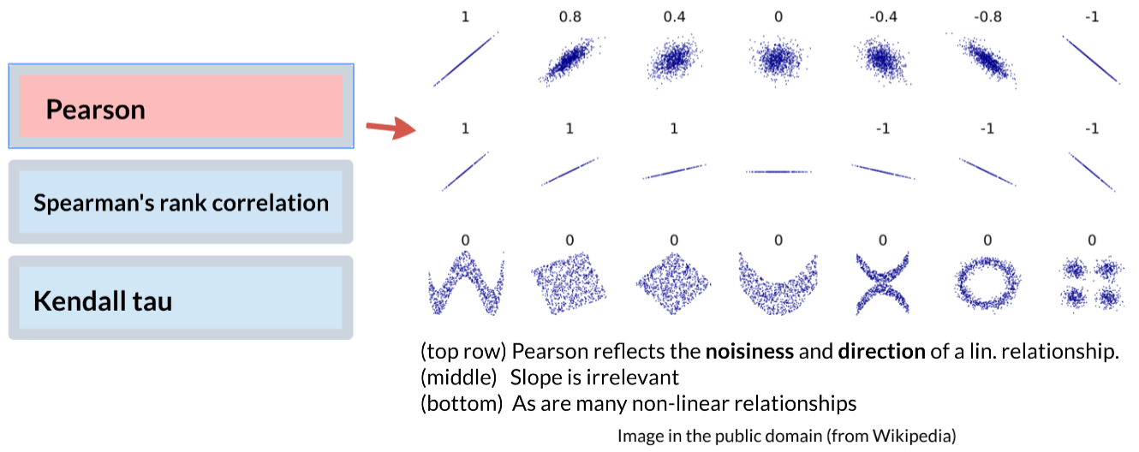
Autocorrelation - Correlation
(commonly) refers to the degree to which a pair of variables are linearly related
Notes:
To understand autocorrelation, let's take a quick refresher on Correlation. The definition of Correlation is very broad, but it usually boils down to how well you can fit a straight line through your dataset. The most popular way to measure Correlation is the Pearson correlation coefficient. On the right you can see 21 different example datasets and their respective pearson coefficient.

Slide 28

In Practice
What we need:
AUTOCORR(X, LAG)
What we have:
XCORR(X, Y,..., LAG)
Solution:
XCORR(X,X, LAG)
Notes:
In practice you don't do this by hand, you would use software like Matlab or Octave, they have those sorts of functions built-in. But even if they don't have a autocorrelation function, we can do a little trick and use Cross-Correlation, which is designed to take as input two different signals, X and Y, but if you give it two times the same signal, the result will be the same as if you had autocorrelation.

Slide 29
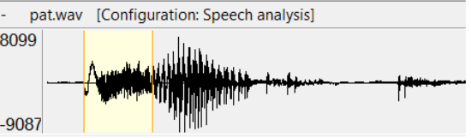
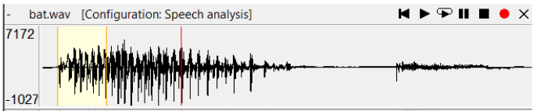
Voiced
Unvoiced
voice box on
/b/: bat /d/: dad /g/: gap
voice box off
/p/: pat
/t/: tap
/k/: cat
All vowels
are voiced
Notes:
Let's look into voiced and unvoiced sounds a bit deeper. On the left you can see some examples for voiced sounds. For example, /b/ as in "bat". On the right side are some unvoiced sounds. For example /p/ as in "pat".
In the following waveforms, it is pretty easy to distinguish the voiced /b/ from the unvoiced /p/. The first waveform shows "pat". The selected part is the /p/ part. You can see the way it differes visually from the following vowel. The /b/ sounds below is definitely voiced. Also, all vowels are voiced.

